Slide 1
│Visual Imaging Effects
Real-IAD D3 Visual Imaging Report
By Rongcheer
Rev. 1.0

Slide 2
│Contents
01
Detailed Explanation of Optical Hardware Functions
02
Comparison of Imaging Advantages
03
Multi-Head Structured Light Parameters
04
2D RGB and Photometric Stereo Imaging
05
3D Point Cloud Imaging
06
2D/3D Point Cloud Acquisition Principle

Slide 3
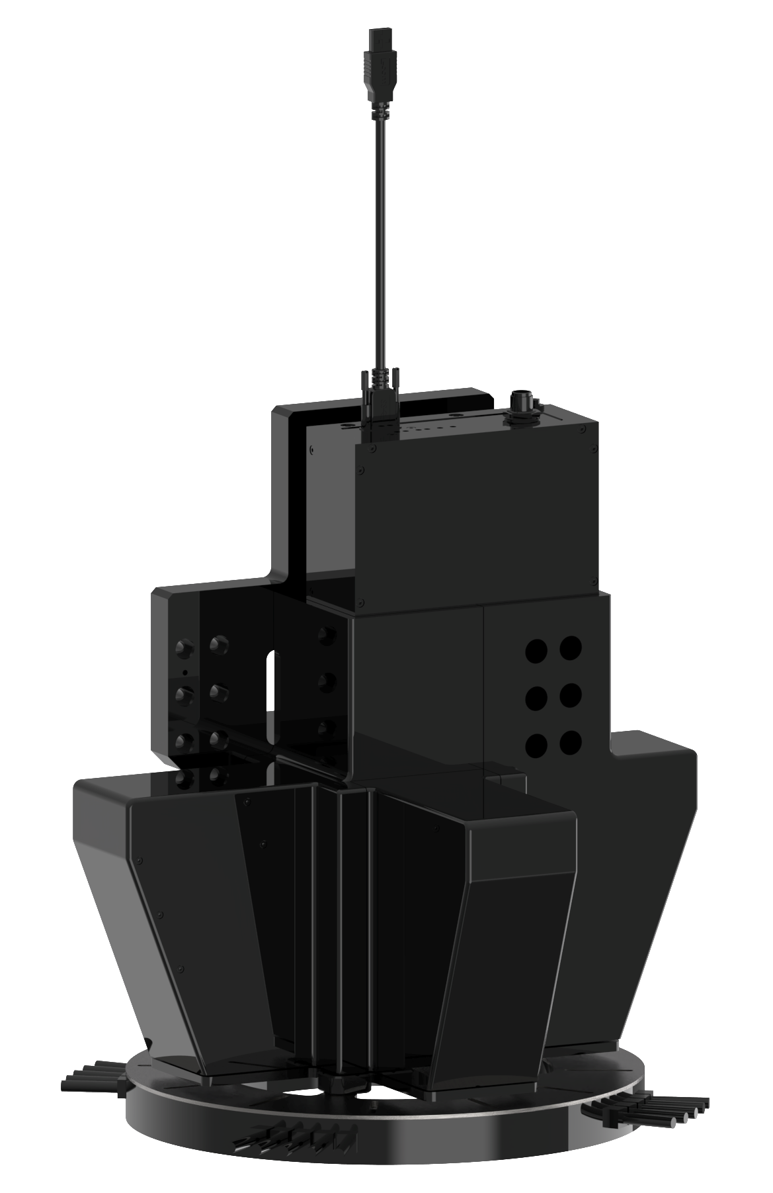
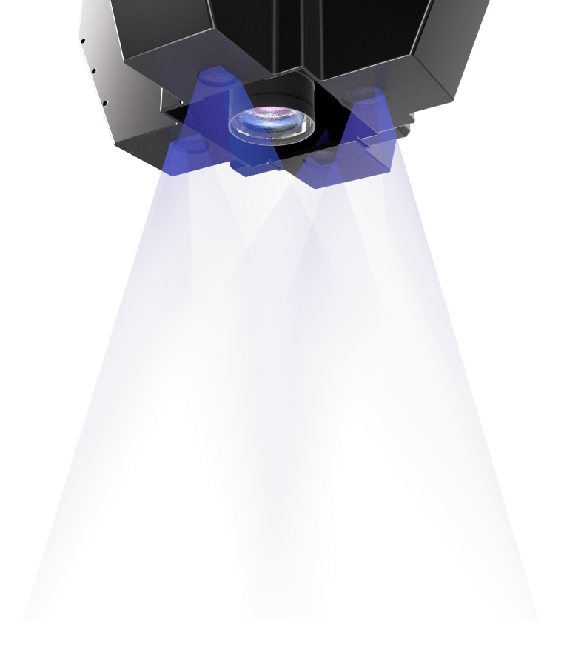
│Visual Imaging Effects │ Detailed Explanation of Optical Hardware Functions
Multi-Head Structured Light Camera:
It can achieve pixel-level alignment of 2D and 3D data.
With ultra-high resolution and ultra-fast full-cycle frame rate, relying on the industry-leading S technology platform, it is capable of obtaining high-resolution 3D data and high-precision, Bayer matrix-free 3CCD true color images in a one-stop manner, truly realizing the integrated detection of 2D + 3D.
The camera hardware end can realize functions such as HDR fusion, noise reduction, repair, speckle removal, RT matrix transformation, and range checking, allowing the PC end to completely get rid of point cloud processing and focus on applications.

Slide 4
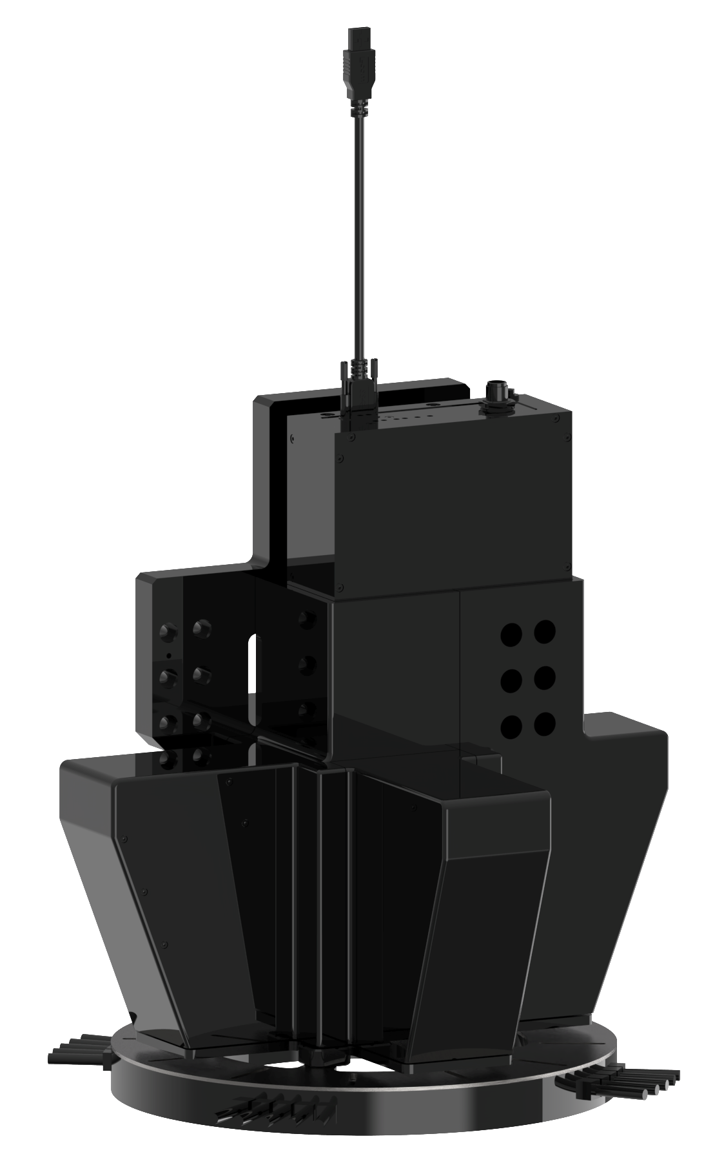
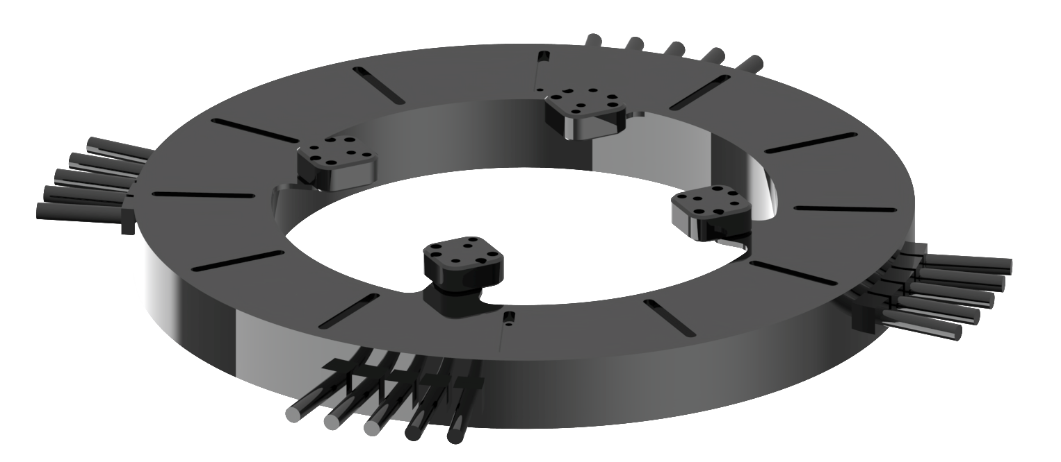
│Visual Imaging Effects │ Detailed Explanation of Optical Hardware Functions
RGBW Quad-Zone Light Source:
Different colors of light have varying reflection and absorption characteristics on objects. When inspecting objects of different colors or materials, selecting a light source color that contrasts with the object's color can make the object's features more prominent.
By illuminating with light of different angles and colors, the three-dimensional information of the object can be more comprehensively displayed. Each zone of the light source can illuminate the object from different directions, causing the object's surface features such as concavities, convexities, and undulations to produce different light and shadow effects in the image. This establishes a 2.5D system that helps the inspection system more accurately obtain the object's three-dimensional shape and structural information.

Slide 5
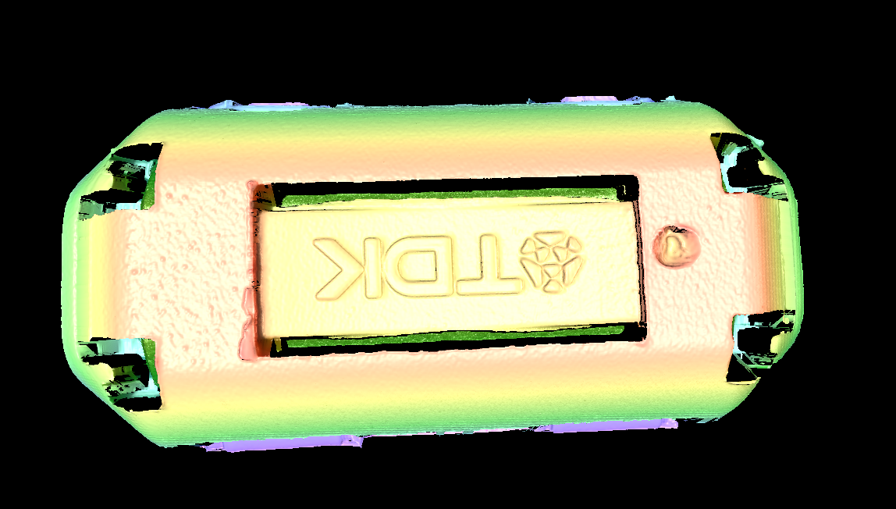
│Visual Imaging Effects │ Comparison of Imaging Advantages
Name | Multi-Head Structured Light
Reference Model | SQ081017
FOV（mm） | 17.7*17.7
Point Precision | ＜0.1
Spatial Distance | 0.006
Photometric Stereo | √
Image
Advantages | Four-Projection Mode： The imaging is complete, with no blind spots around. By obtaining image information from multiple perspectives, it can more comprehensively capture the features and spatial information of the object, making the depth calculation more accurate and reliable.
2D Image
3D Image

Slide 6
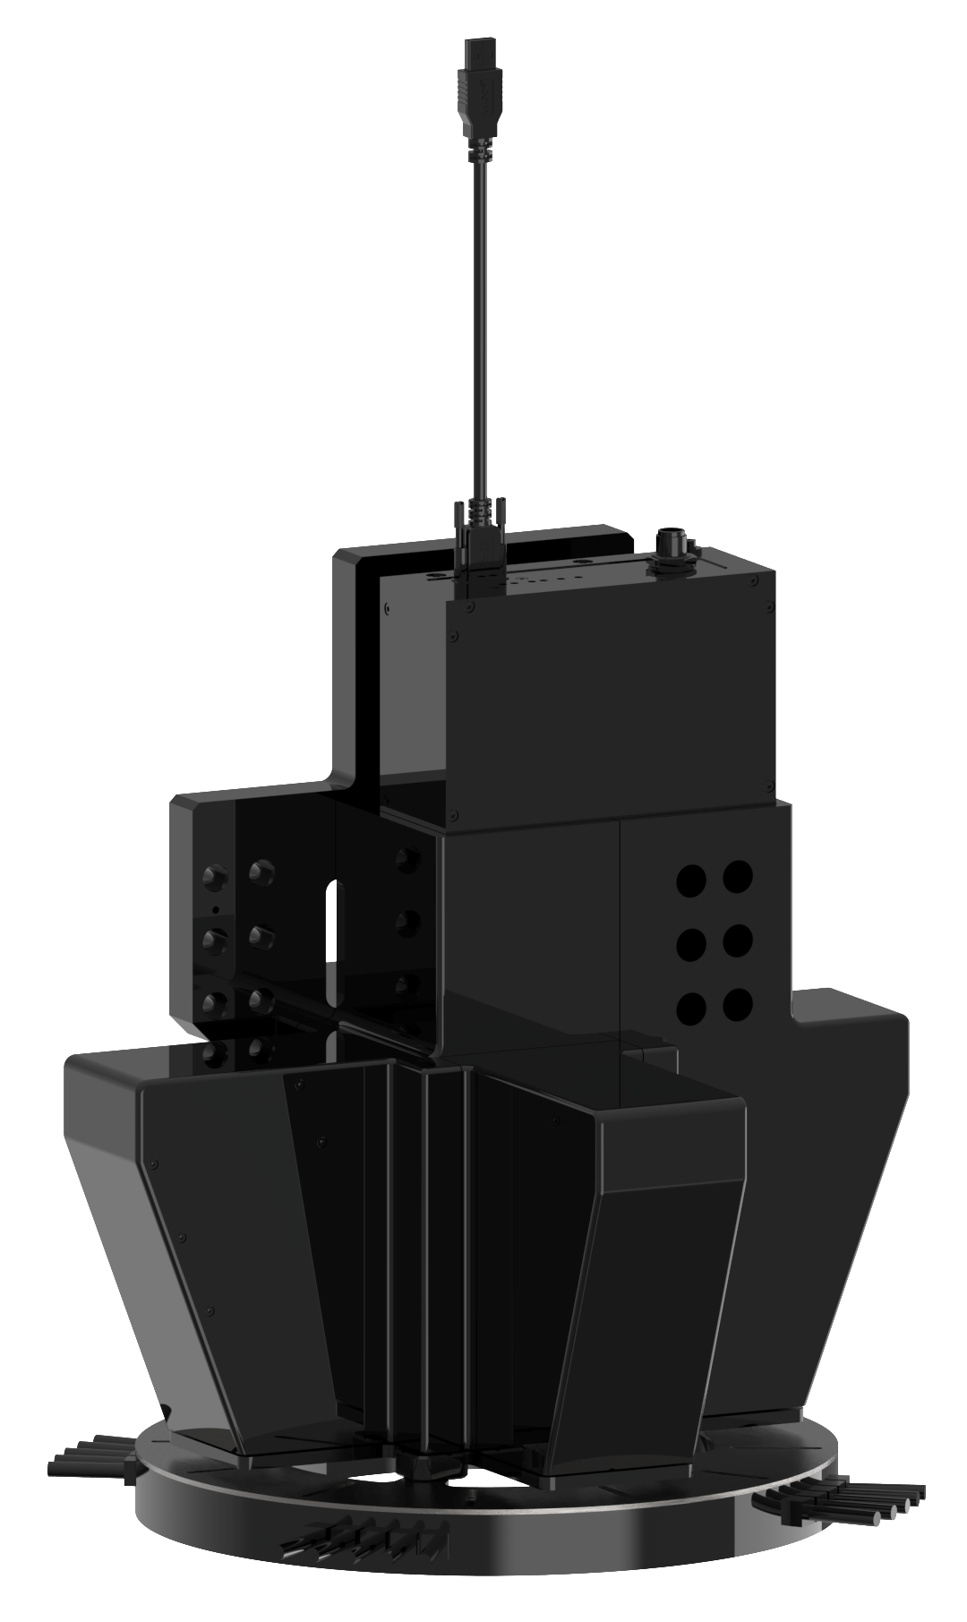
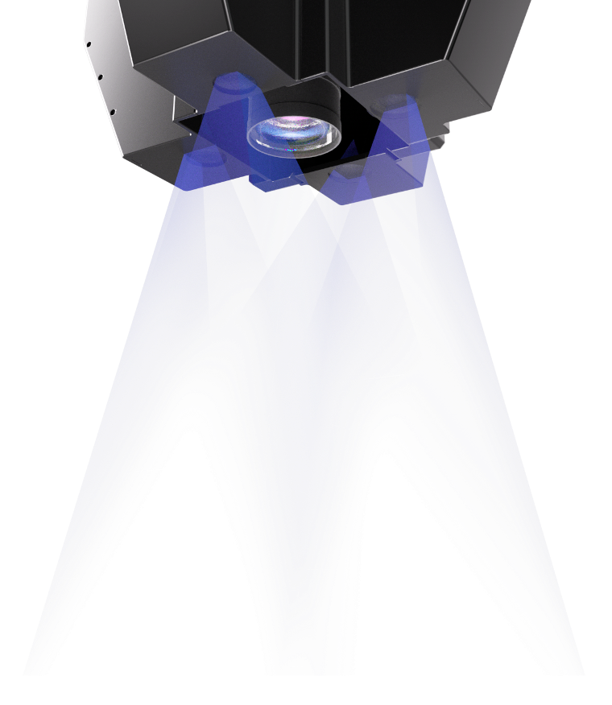
│Visual Imaging Effects │ Multi-Head Structured Light Parameters
Multi-projection + Zoned Light Source
Camera | SQ081017 | Resolution | 2856*2848
 |  | Quantity | 1
 |  | Installation Angle | 90°
 |  | Baseline Distance | 115mm
 |  | Standard Field of View Range | 17.7mm*17.7mm
 |  | Depth Measurement Range | ±2mm
 |  | Z-axis Repeatability | <0.1um
 |  | Pixel Accuracy | 0.006mm/pixel
Zoned Light Source | 27000-RGBWIR850 | Quantity | 1
 |  | Installation Angle | 90°

Slide 7
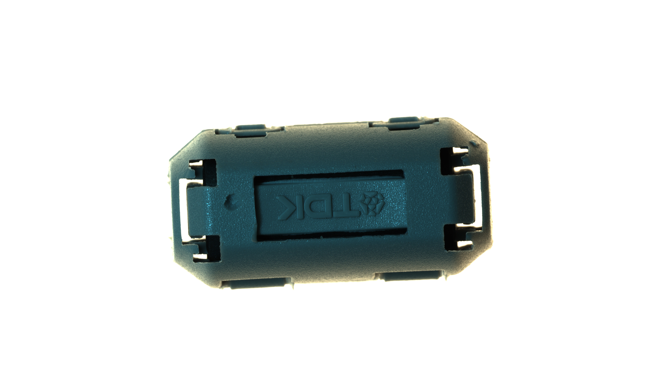
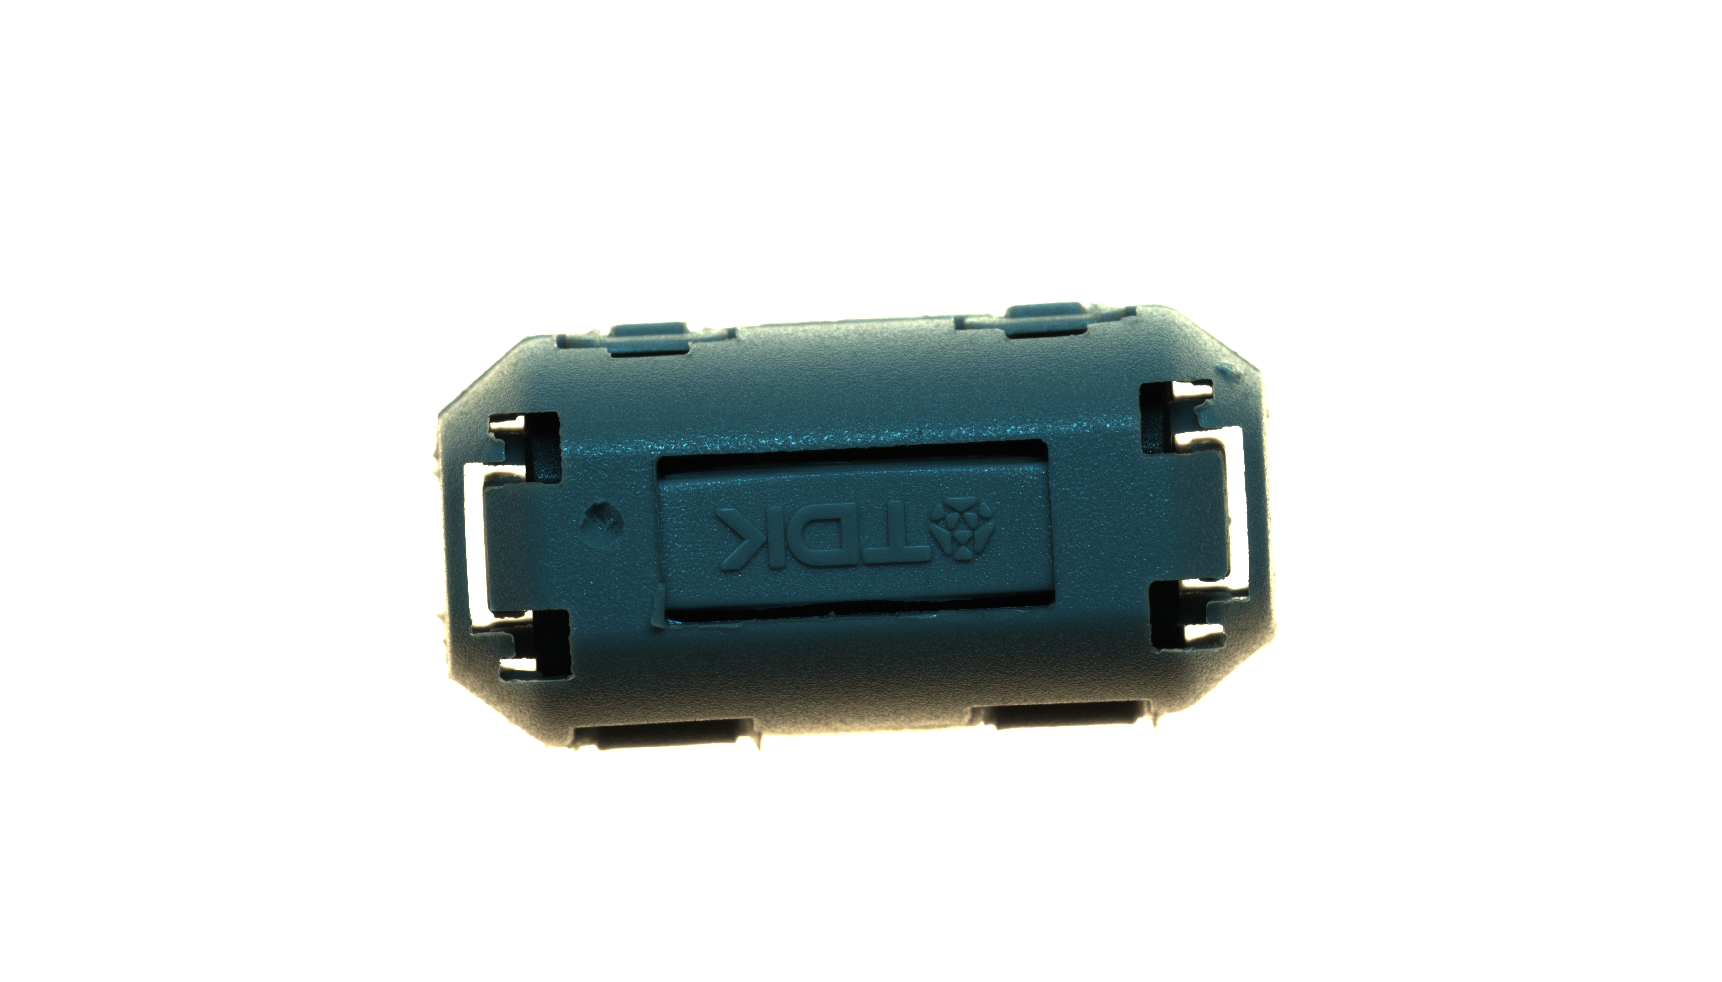
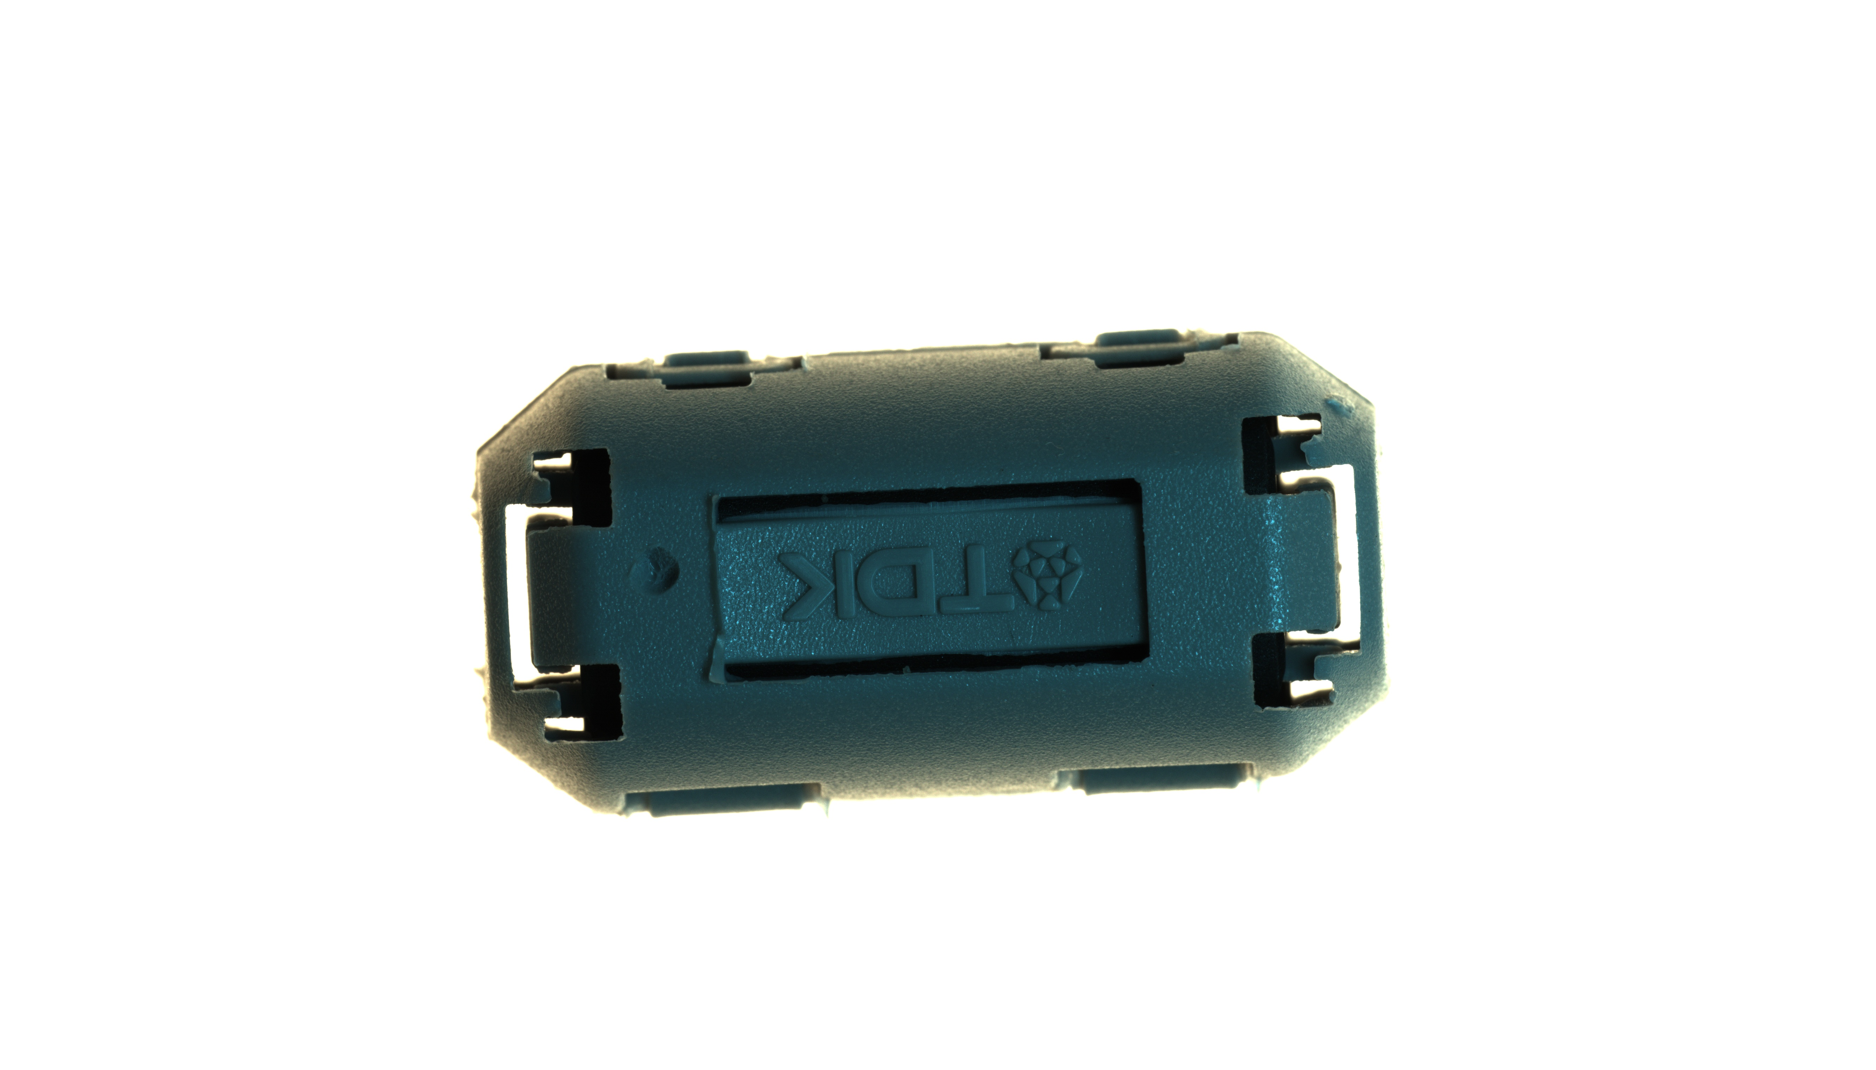
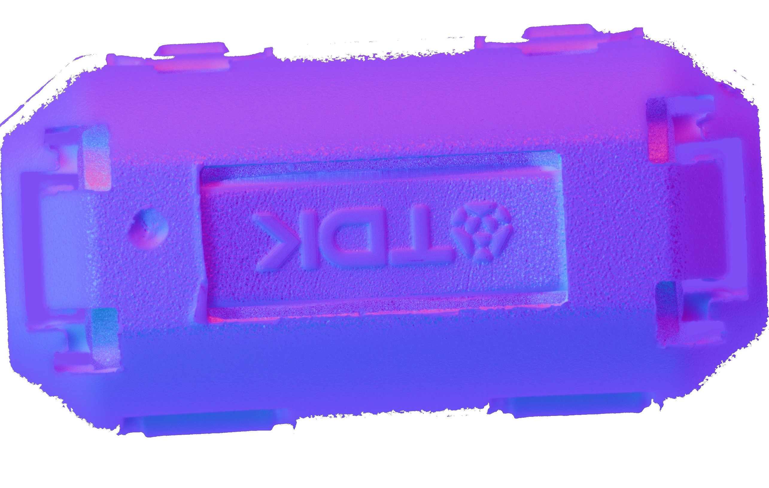
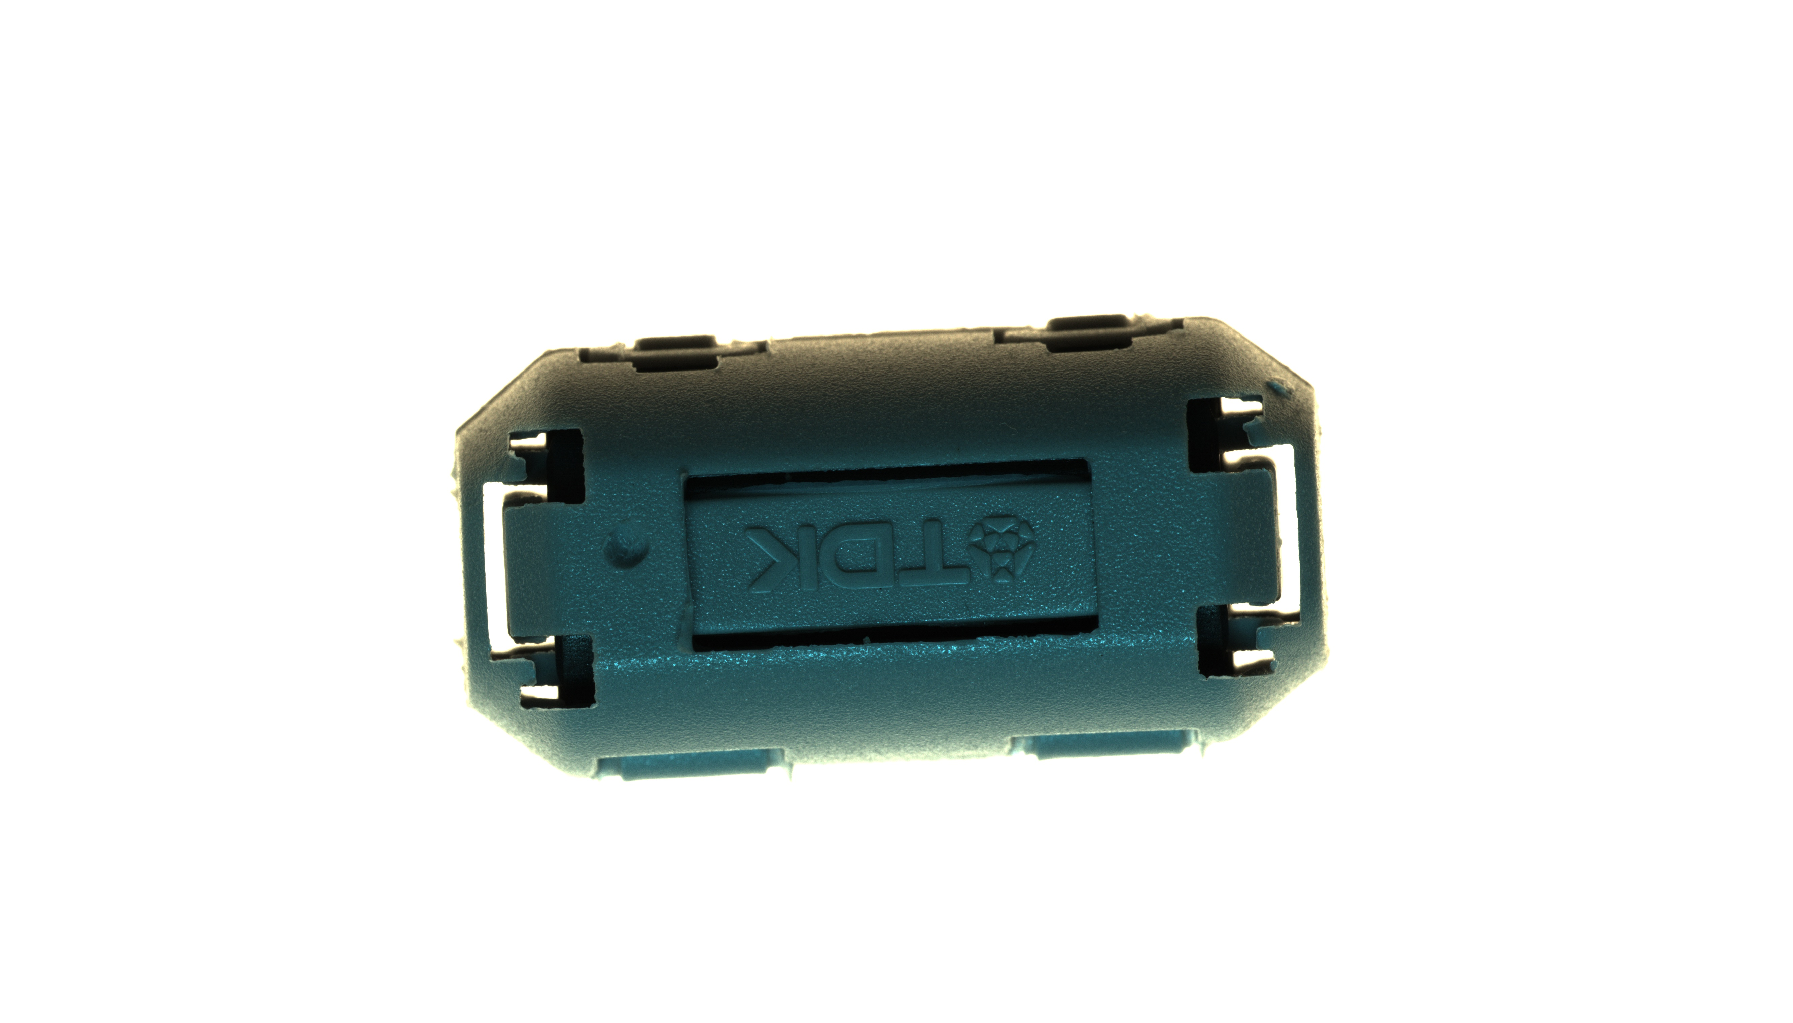
│Visual Imaging Effects │ 2D RGB and Photometric Stereo Imaging
Photometric Stereo Fusion Image
RGB Composite Image

Slide 8
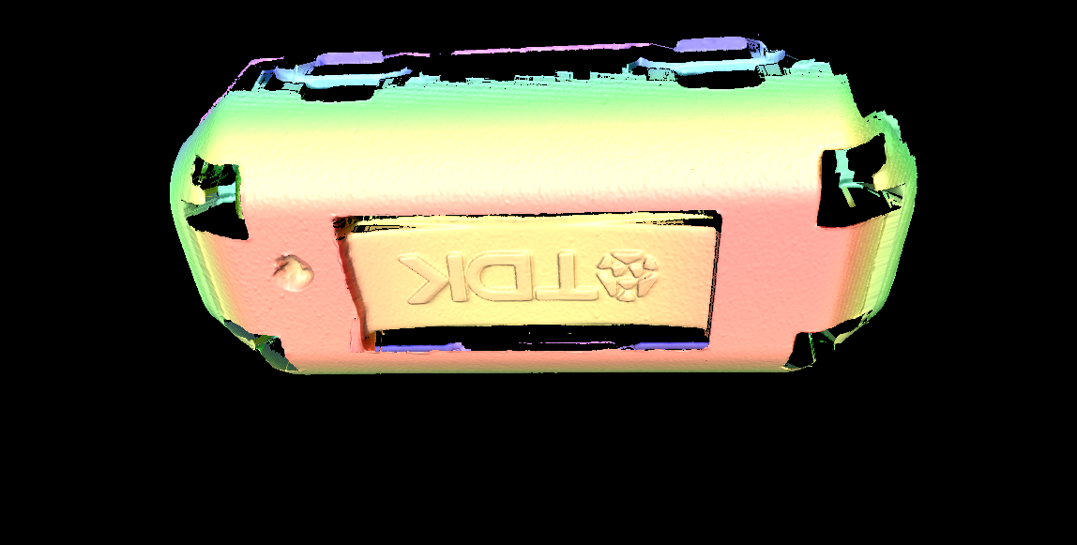
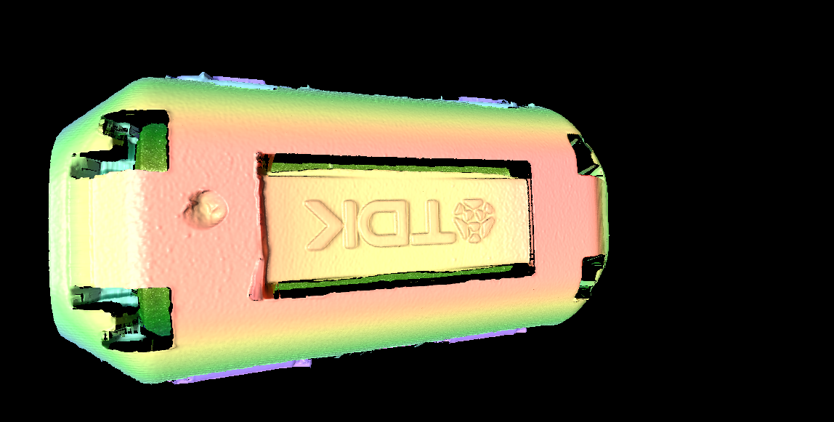
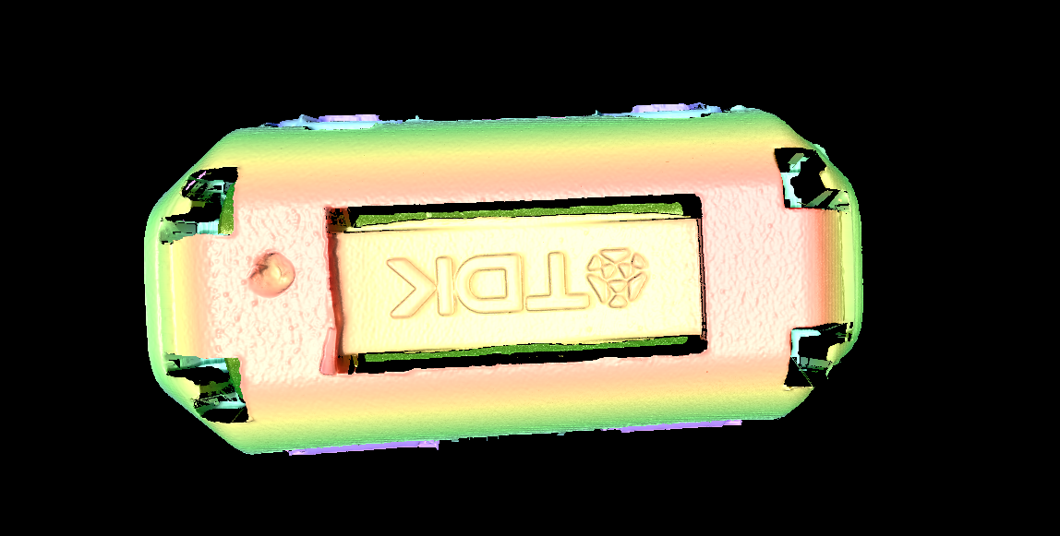
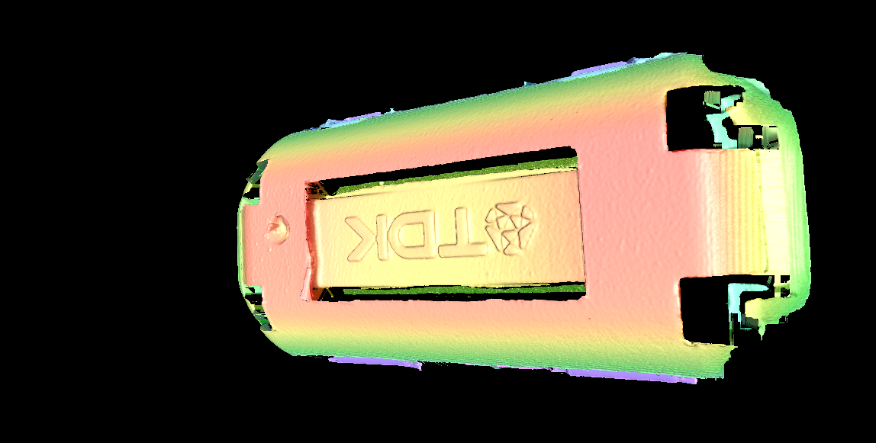
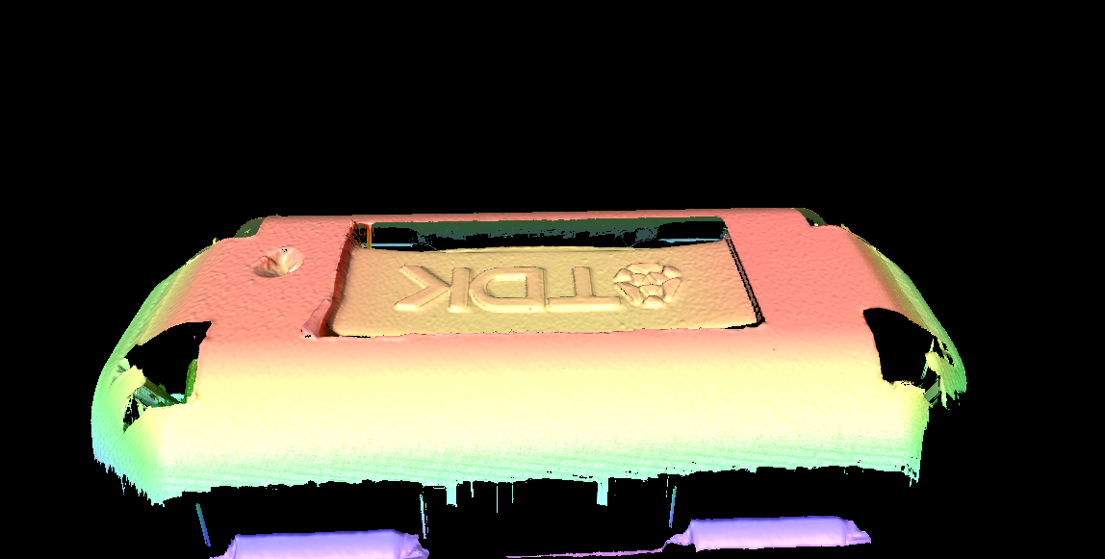
│Visual Imaging Effects │ 3D Point Cloud Imaging

Slide 9
│Visual Imaging Effects │ 2D/3D Point Cloud Acquisition Principle
Equipped with multi-projection and hardware computing imaging technology, it can eliminate image shadows and blind spots caused by a single projection direction, and also solves the 3D reconstruction distortion problems such as single-side speckles and holes that are prone to occur on highly reflective object surfaces.
It can achieve one-stop 2D + 3D fusion measurement and inspection with external light source synchronization. The external RGB light source can obtain true color 3D point clouds with no Bayer matrix and 3CCD imaging effects.
The hardware end performs multiple 3D fusions and outputs high-precision 3D point clouds. Compared with PC-based systems, the data transmission volume is significantly reduced, and the computing time is not increased.

